Slide 1









AWS API Gateway
The Front Door for Your Applications
Create, publish, maintain, monitor, and secure APIs at any scale

Slide 2








What is API Gateway?
Amazon API Gateway is a fully managed service that empowers developers to create, publish, maintain, monitor, and secure APIs at any scale.
Front Door for Applications
Serverless Approach
Built-in Security
Abstracts away much of the complexity involved in managing API infrastructure, allowing developers to focus on core application logic.
Provides integrated security features such as IAM authentication, Lambda authorizers, and integration with AWS WAF for protection against common web exploits.
Serves as the "front door" for applications to access data, business logic, or functionality from various backend services.
Key Benefits
Fully managed service
Automatic scaling
Integrated monitoring
Simple deployment

Slide 3





















Fundamental Architecture
AWS API Gateway acts as a crucial intermediary layer between client applications and backend services, managing the flow of requests.
Client Applications
API Gateway
Backend Services
The "front door" for your applications
Mobile, web, and desktop applications making API requests
AWS Lambda, HTTP endpoints, other AWS services
Authentication
Throttling
Request Routing
Request Routing
Traffic Management
Security Enforcement
Directs requests to appropriate backend services
Controls request flow through throttling and caching
Implements auth and authorization mechanisms

Slide 4













EC2-Hosted API vs AWS API Gateway
EC2-Hosted API
AWS API Gateway
Manual Approach
Managed Approach
Infrastructure Provisioning
Infrastructure Management
Manually launching and configuring EC2 servers, including selecting instance types, operating systems, and network settings.
AWS fully manages the underlying infrastructure, eliminating the need to provision, patch, or maintain servers.
Web Server Installation
No Server Management
Installing and configuring web server software (e.g., Nginx, Apache HTTP Server) to handle HTTP requests.
Serverless approach with no server management required.
API Deployment
Simplified Deployment
Manually deploying the API code onto the EC2 instance, often requiring SSH access and file transfer protocols.
Facilitates easy deployment and versioning of APIs through stages, allowing for controlled rollouts and quick rollbacks.
Security Management
Built-in Security
Regularly applying security patches and updates to the operating system, web server, and API dependencies.
Provides integrated security features such as IAM authentication, Lambda authorizers, Cognito user pools, and integration with AWS WAF.

Slide 5










Supported API Types
REST APIs
HTTP APIs
WebSocket APIs
Protocol:
Protocol:
Protocol:
HTTP/HTTPS
HTTP/HTTPS
WebSocket
Key Characteristics:
Key Characteristics:
Key Characteristics:
Feature-rich control
Lightweight, cost-efficient
Real-time, bidirectional communication
Integration with AWS services
Simple to create & maintain
Stateful connections
IAM, Lambda authorizers
IAM, Lambda authorizers
Efficient for persistent connections
Cognito User Pools
Cognito User Pools
Full-duplex communication
API keys, WAF integration
API keys, WAF integration
OAuth 2.0 and OIDC
Primary Use Cases:
Traditional web & mobile apps
Primary Use Cases:
Primary Use Cases:
Complex business logic
Simple web & mobile apps
Live chat applications
Integration with various AWS services
Microservices
Real-time dashboards
Serverless applications
Notification systems
Gaming, collaborative applications

Slide 6





















HTTP Verbs
HTTP verbs define the type of action to be performed on a resource. API Gateway supports standard HTTP methods for defining these actions.
GET
POST
PUT
PATCH
Retrieves a resource or data from the server.
Creates a new resource or submits data to the server.
Replaces an existing resource entirely with new data.
Partially updates an existing resource.
DELETE
HEAD
OPTIONS
ANY
Removes a specified resource from the server.
Retrieves only the headers of a resource, without the response body.
Describes the communication options for the target resource.
A catch-all method for any HTTP verb.

Slide 7










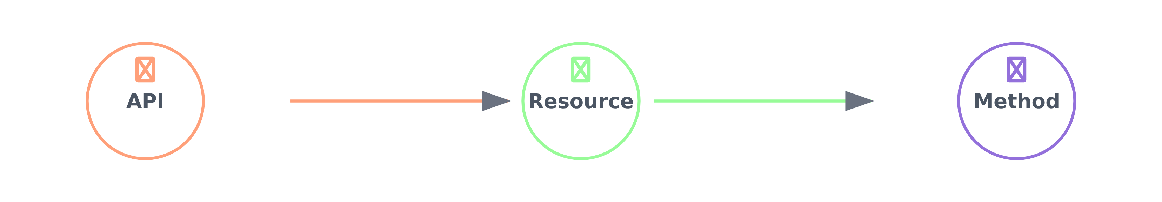
Core Components
API Gateway consists of three fundamental components that work together to define and manage your API's functionality and deployment.
Resources
Methods
Stages
Logical entities identified by URL paths that clients can interact with. They form a hierarchical structure and are the building blocks of your API.
Operations performed on resources, corresponding to HTTP verbs (GET, POST, PUT, DELETE). Each method defines the flow for handling client requests.
Logical references to specific deployments of your API, representing lifecycle states like dev, test, beta, or prod. Each stage has its own invoke URL.

Slide 8




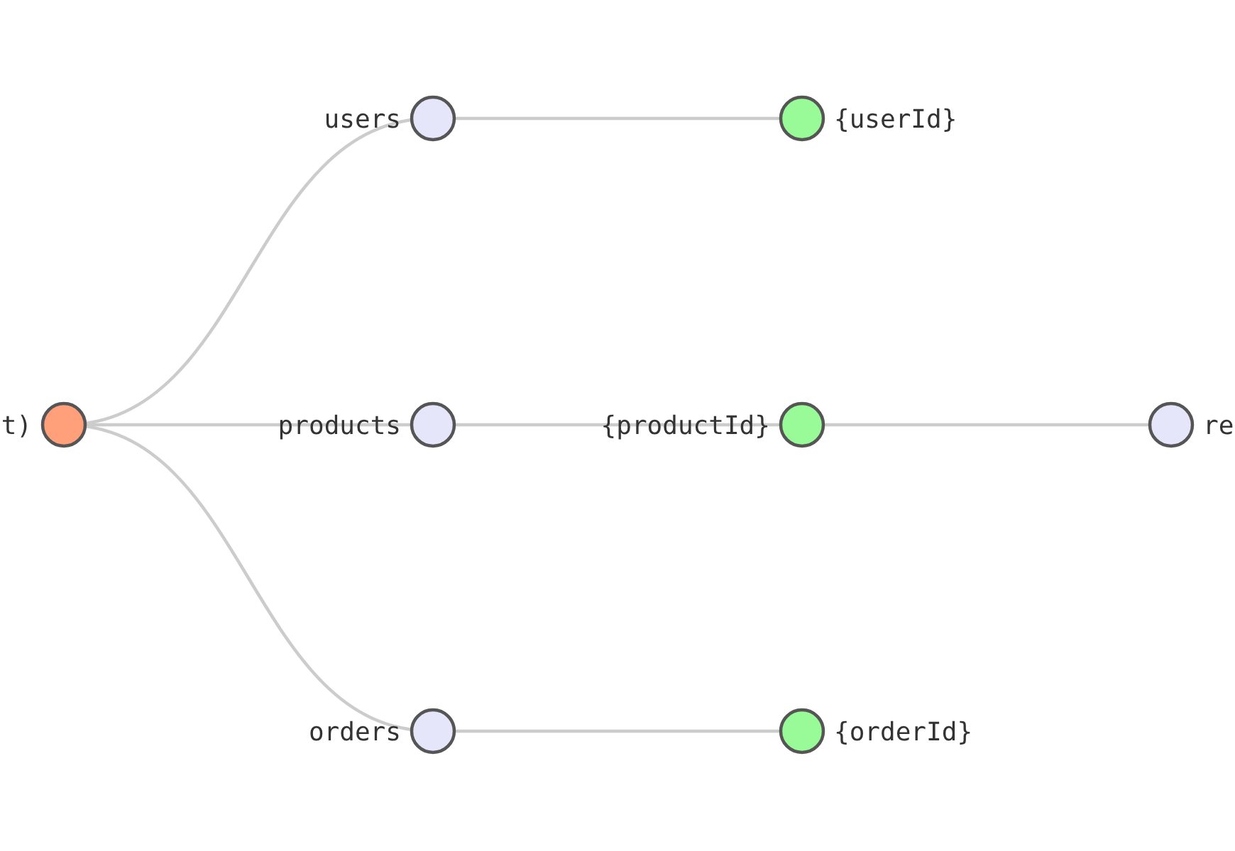




Resources
Resources are the fundamental building blocks of an API, representing logical entities or paths that clients can interact with.
Key Characteristics
Organized in a hierarchical structure, forming a resource tree
Identified by URL paths (e.g., /users, /products/{productId})
Each resource can expose one or more API methods (GET, POST, PUT, DELETE, etc.)
Support URI templates for parameterized paths
Example
For an e-commerce API:
/users - Represents all users
/users/{userId} - Represents a specific user
/products/{productId}/reviews - Represents reviews for a specific product

Slide 9





















Methods
Methods are specific operations that can be performed on a resource, corresponding to HTTP verbs and defining the complete flow for handling a client request.
Method Request Handling Flow
Client Request
Authorization
Request Validation
Backend Integration
Response Transformation
GET
POST
PUT
DELETE
Retrieves a resource or data from the server.
Creates a new resource or submits data to the server.
Replaces an existing resource entirely with new data.
Removes a specified resource from the server.

Slide 10










Stages
A stage in API Gateway is a logical reference to a specific deployment of your API, representing a lifecycle state such as dev, test, beta, or prod.
Unique Identification
Independent Configuration
Each stage is identified by its API ID and a unique stage name, with its own invoke URL for accessing the API.
Stages allow for independent configuration of settings like caching, logging, throttling, and variables.
Version Control
Phased Rollouts
Stages facilitate API version control, allowing you to maintain multiple versions of your API simultaneously.
Stages enable controlled rollouts and quick rollbacks, allowing for phased deployments to gradually expose your API to users.
Stage Lifecycle
Dev
Test
Prod

Slide 11








Traffic Management
API Gateway offers advanced traffic management capabilities to ensure API stability and optimal performance.
Request Throttling
Request Quotas
Limits the number of requests that clients can submit to an API within a given time frame, preventing backend overload.
Defines the maximum number of requests that a given API key can make over a specified period.
Usage control and enforcement
Protects backend services from overload
API key-based limitations
Ensures consistent performance
Response Caching
Load Balancing
Caches API responses to reduce the load on backend services and improve response times for frequently accessed data.
Distributes incoming API traffic across multiple backend instances, enhancing availability and fault tolerance.
Reduced backend load
Improved availability
Faster response times
Better fault tolerance

Slide 12









Practical Use Cases
Serverless Applications
Microservices Architecture
Real-Time Communication
API Gateway acts as the crucial HTTP endpoint for AWS Lambda functions, enabling the creation of scalable, event-driven serverless backends for web and mobile applications.
In a microservices architecture, API Gateway serves as a unified entry point, simplifying client interaction by routing requests to the appropriate downstream service.
API Gateway's WebSocket APIs are fundamental for enabling real-time, bidirectional communication, essential for applications requiring persistent, full-duplex connections.
Provides centralized management of multiple services
Exposes Lambda functions via REST or HTTP APIs
Offers consistent security, monitoring, and traffic management
Enables live chat applications
Supports real-time dashboards and notifications
Streamlines serverless architecture development
Simplifies client interaction with complex systems
Manages persistent, full-duplex connections efficiently
Enables event-driven computing

Slide 13








Question 1
Which API Gateway type is optimized for building real-time, two-way communication applications like chat apps and streaming dashboards?
A
REST API
B
HTTP API
C
WebSocket API
D
Private API

Slide 14














Answer 1
Correct Answer: C. WebSocket API
Explanation:
WebSocket APIs are specifically designed for real-time, two-way communication applications, such as chat applications and streaming dashboards, by maintaining persistent connections between clients and backend services.
Chat Applications
Streaming Dashboards
Two-Way Communication
Real-time messaging between users
Live data visualization and updates
Persistent connections for bidirectional data flow

Slide 15









Question 2
What is a key characteristic that differentiates HTTP APIs from REST APIs in AWS API Gateway?
A
HTTP APIs support API keys and per-client throttling
B
HTTP APIs offer more comprehensive features
C
HTTP APIs are generally lower cost and offer lower latency
D
HTTP APIs support caching

Slide 16





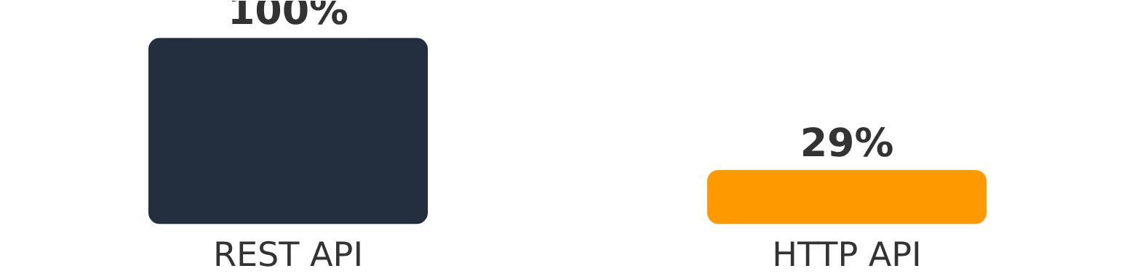
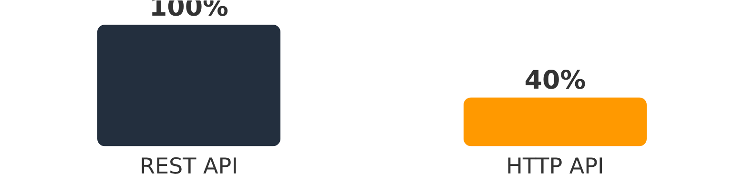
Answer 2
Correct Answer: C
Explanation:
HTTP APIs are highlighted as being up to 71% cheaper and offering lower latency compared to REST APIs. This makes them suitable for simpler, high-performance use cases, especially with serverless workloads.
Cost Comparison
Latency Comparison
HTTP APIs are up to 71% cheaper than REST APIs
HTTP APIs offer lower latency for simple use cases

Slide 17





Question 3
Which of the following is a primary use case for AWS API Gateway's REST APIs?
A
Building real-time chat applications
B
Creating lightweight APIs for serverless workloads
C
Developing complex APIs requiring advanced features
D
Establishing persistent connections for streaming data

Slide 18










Answer 3
Correct Answer: C
Developing complex APIs requiring advanced features like API keys and request validation.
REST APIs are described as fully-featured with comprehensive functionality, supporting advanced features such as API keys, per-client throttling, request validation, and AWS WAF integration.
REST API
HTTP API
WebSocket API
API keys
Limited features
Real-time communication
Per-client throttling
No API keys
Persistent connections
Request validation
No per-client throttling
Not for complex APIs
AWS WAF integration
No request validation
No throttling

Slide 19














Question 4
When choosing between REST APIs and HTTP APIs, which scenario would strongly favor using an HTTP API?
A
The API requires integration with AWS WAF
B
The API needs per-client throttling
C
The primary goal is to minimize cost and achieve low latency
D
The API requires custom transformations
HTTP API
REST API
Up to 71% cheaper than REST APIs
Integration with AWS WAF
Lower latency for simple use cases
Per-client throttling and API keys
Ideal for serverless workloads
Custom request/response transformations

Slide 20



Answer 4
Correct Answer: C. The primary goal is to minimize cost and achieve low latency for a simple proxy to a Lambda function.
Explanation:
HTTP APIs are specifically designed for lower cost and lower latency, making them ideal for simple proxy functionalities, especially with serverless workloads like Lambda functions. Features such as AWS WAF integration, per-client throttling and API key management, and custom request/response transformations with VTL are typically available with REST APIs, which offer a richer feature set at a higher cost.
HTTP API Benefits
REST API Features
Up to 71% cheaper than REST APIs
AWS WAF integration
Lower latency for simple use cases
Per-client throttling and API key management
Ideal for serverless workloads
Custom request/response transformations
Simplified pricing model
Comprehensive feature set

Slide 21



Question 5
Which API Gateway component represents a logical entity in your API, such as `/users` or `/orders`?
A
Method
B
Stage
C
Resource
D
Deployment

Slide 22















Answer 5
Correct Answer: C. Resource
A Resource in API Gateway represents a logical entity in your API.
A Resource is a logical entity that represents a specific path or endpoint in your API, such as /users or /orders.
Resource Structure in API Gateway:
API
Resource
Method
/users
/orders
Key Points:
Resources represent specific paths or endpoints in your API
Methods are HTTP verbs associated with a resource
Stages are named references to a deployment
Deployments are snapshots of your API configuration

